Slide 1
Society Council
Clare, Jamie, Claire, David, Sabbatical Team

Slide 2
INtro
Chinese Students & Scholars
Christian Union
Games Development
Nordic Society
Roleplaying Games Paisley
Roleplaying Games Lanarkshire
Friends of the Bees
Party Dance Society
Pharmaceutical Society
Photography Society
Barriers to Learning
African and Caribbean
Aerial Arts
Blue Space Society
LGBT+
International Students Officer
Woman's Group
Disabled Students Group

Slide 3
Welcome
Todays Agenda:
1.00-1.20 Intro
1.20-1.35 Welcome to 20/21 Term
1.35-2.00 update on freshers plans
2.00-2.10 Comfort break
2.10-2.35 Web page Training
2.35-2.40 Feedback Discussion
2.40-2.55 Guidelines for activities
2.55-3.00 Questions

Slide 4
Why am I Here?
*Societies constitution and BYE LAW 5
These will be circulated and top of the agenda for the next meeting
Constitution- Affiliation/ Re-Affiliation/ membership/ Societies committee/ finance/ council/ societies exec Committee (4 elected students) 4 meetings a year
Bye law 5- societies council, all society members, for discussion and debate on society matters, minimum 4 times per year

Slide 5
Questions so many questions
Please use the chat box ☺
The meeting will be kept open at the end for any further informal chat, I’ll also be here in the break

Slide 6
Todays icebreaker
Invite your pets to the meeting

Slide 7
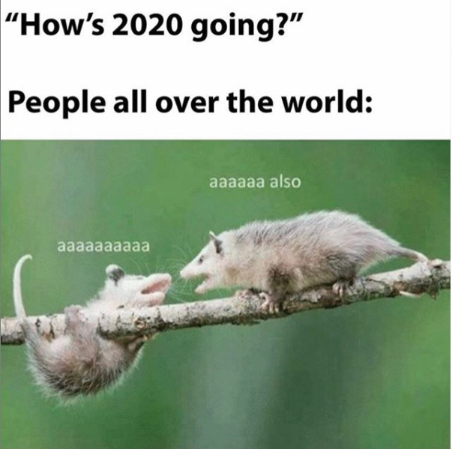
2020

Slide 8
Your Sabbatical Officers
Ismail President
Aishwarya VP Education
Clare VP Student Development
Luke VP Welfare and Wellbeing

Slide 9
What have the union been doing?
Sabbs: planning around manifesto points/ uni meetings/ workstreams/ training for the year ahead
Staff Team: many furloughed- now preparing spaces for return/ uni meetings/ welfare and support
All: planning, re-planning

Slide 10
“Blended learning”
Hot topic
Timetables
Changing government guidance
Since schools went back
Uws- 86 requests for information

Slide 11
Societies - Online (risk and safety) - strangest freshers ever! - will be under constant review as soon as we can have gatherings we will - normal freshers fair is off, campus capacities are going to be very low

Slide 12
Thoughts?

Slide 13
Freshers
No freshers fair
Lots of online events
6 weeks freshers period
Society intro events
Meet and join societies
Promotion is key (logos/ posters/website/ social media)
Videos will help (slideshows/ voiceover/ talking to camera)
Ice breakers / networking / planning / purpose – we can help

Slide 14
Break time
2.00-2.10

